Slide 1


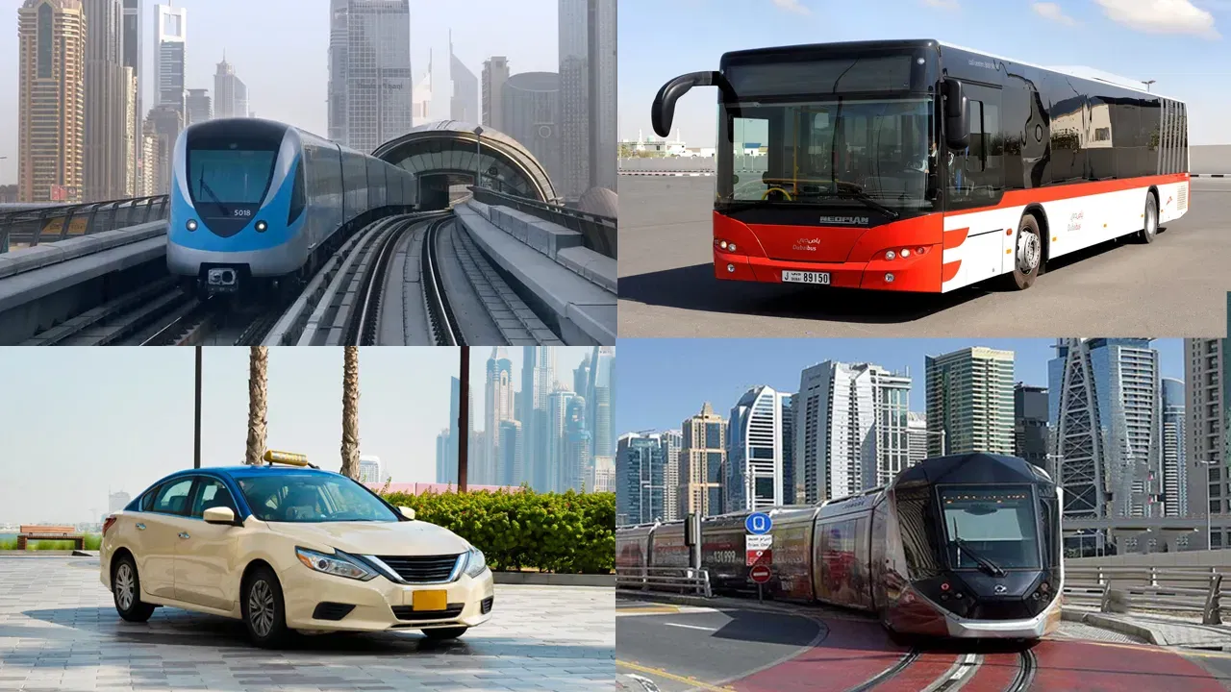

Daily Ridership

Slide 2








Aliaa
​Yasser
Nada
Hamed
Nadia
Hossny
Abdelrhman
Sobhy
Ahmed
Mohamed
Alaa
​Mahmoud
Under supervision of:
Eng/ Osama Adel

Slide 3
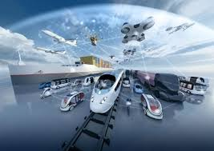
THE METROPOLITAN TRANSPORTATION AUTHORITY (MTA) OPERATES THE LARGEST TRANSPORTATION NETWORK IN NORTH AMERICA, SERVING NEW YORK AND PARTS OF CONNECTICUT

Slide 4
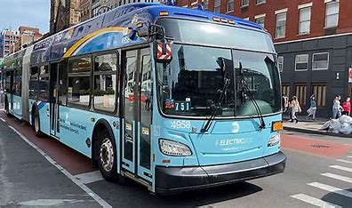
Service
•Subways
• Buses
• Long Island Rail Road (LIRR)
•Metro-North Railroad (MNR)
• Access-A-Ride
•Bridges & Tunnels
•Staten Island

Slide 5

•This dataset provides daily ridership and traffic estimates for various transportation modes, including subways, buses, railroads, and bridges.
•It compares post-COVID-19 ridership to pre-pandemic levels.
• Encourages informed decision-making for transportation planning.

Slide 6


Dataset Overview
•- Total Rows: 1706
•- Total Columns: 15
•- Key Attributes:
• Date, Total Estimated Ridership, % of Comparable Pre-Pandemic Day.
•- Includes ridership data for subways, buses, railroads, and more.
•- Provides comparisons to pre-pandemic ridership levels.

Slide 7
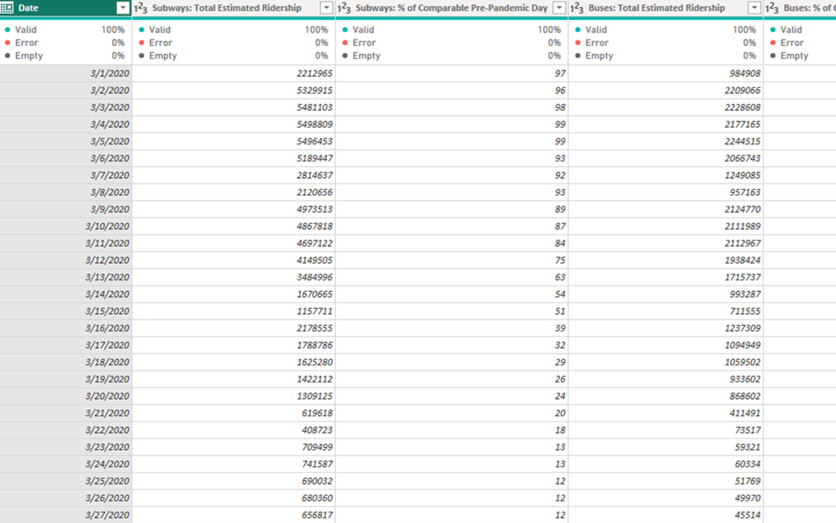
Types of columns
The date is from 2020/3/1 to 2024/ 10 /31 and it represent primary key for the table.
THE ESTIMATED( RIDERSHIP OR SCHEDULED ACCESS A RIDE(AAR) OR TRAFFIC.
the pre-COVID ridership comparison percentages and it is explained later in the presentation.

Slide 8

Transformation

Slide 9

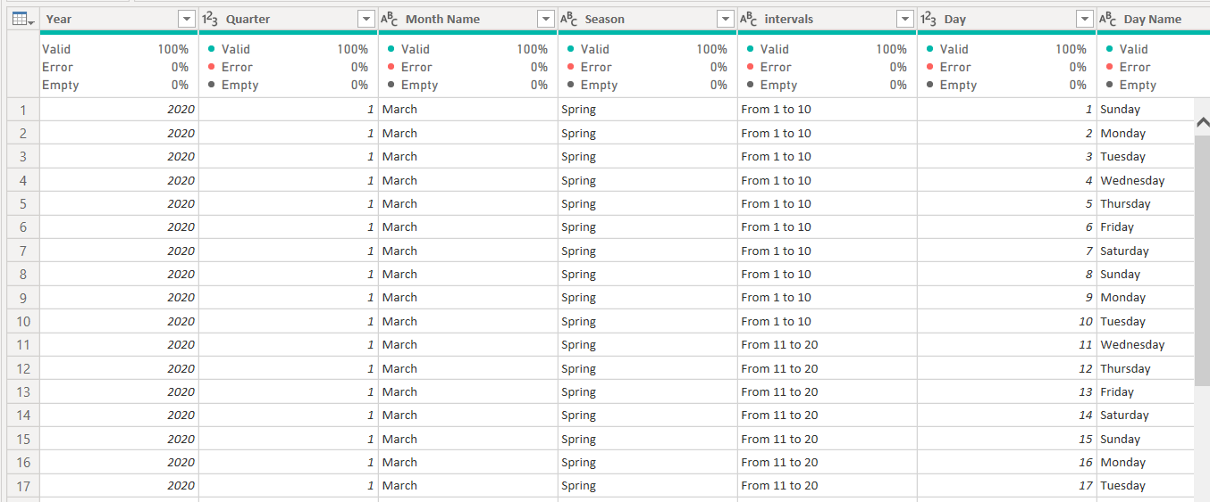
Date

Slide 10
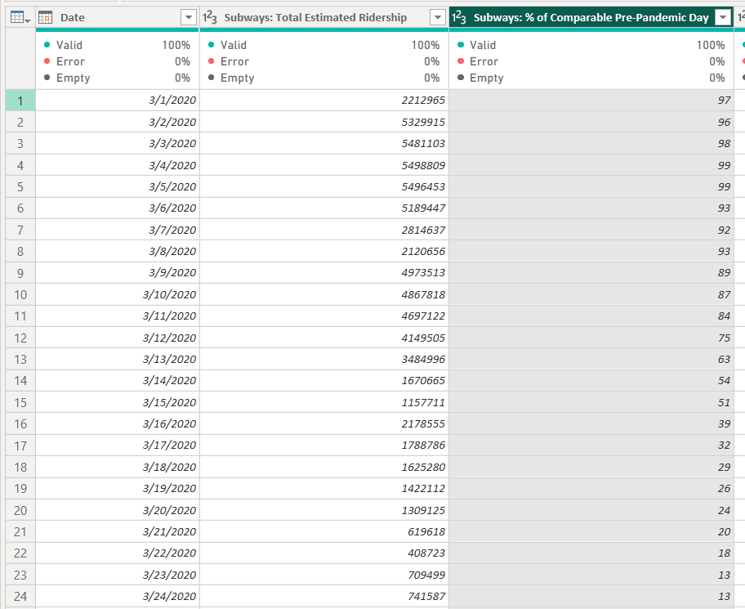



HOW THE PERCENTAGE COLUMNS CALCULATED ?
Total estimated
It's equivalent percentage
Covid ridership numbers

Slide 11
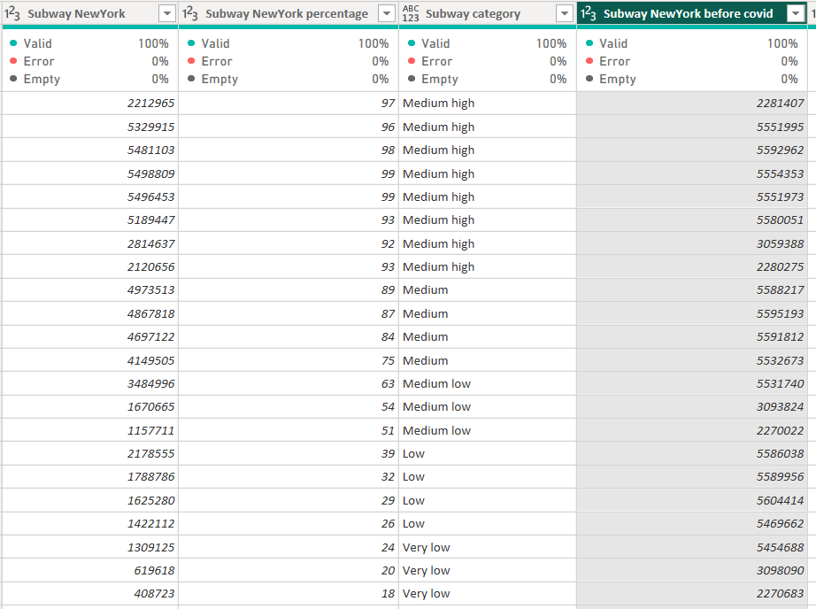
Before covid column

Slide 12
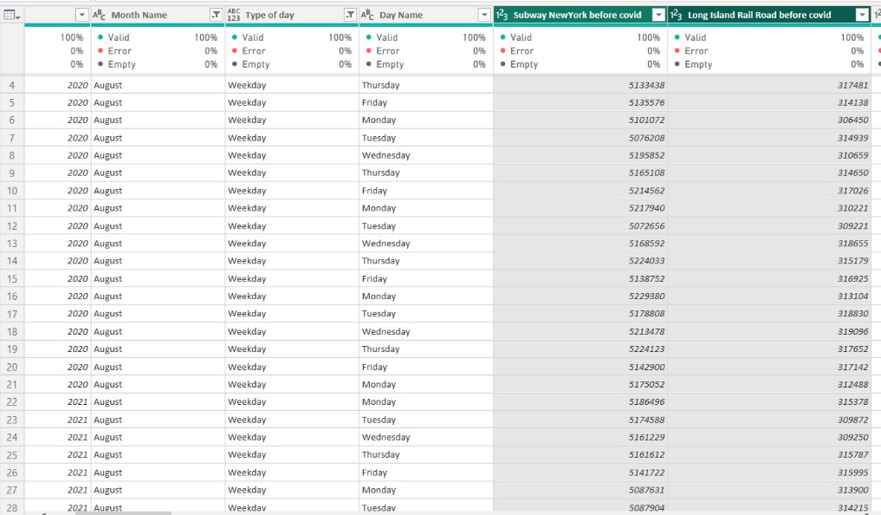
Filter on weekday

Slide 13
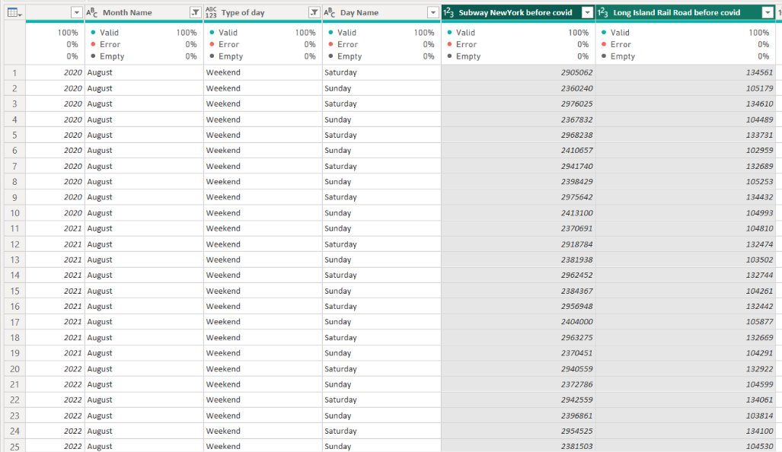
Filter on weekend

Slide 14
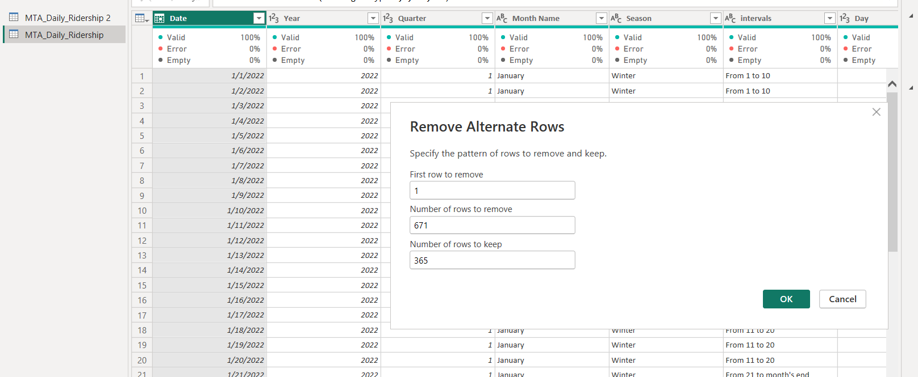
Customize table to 2019

Slide 15

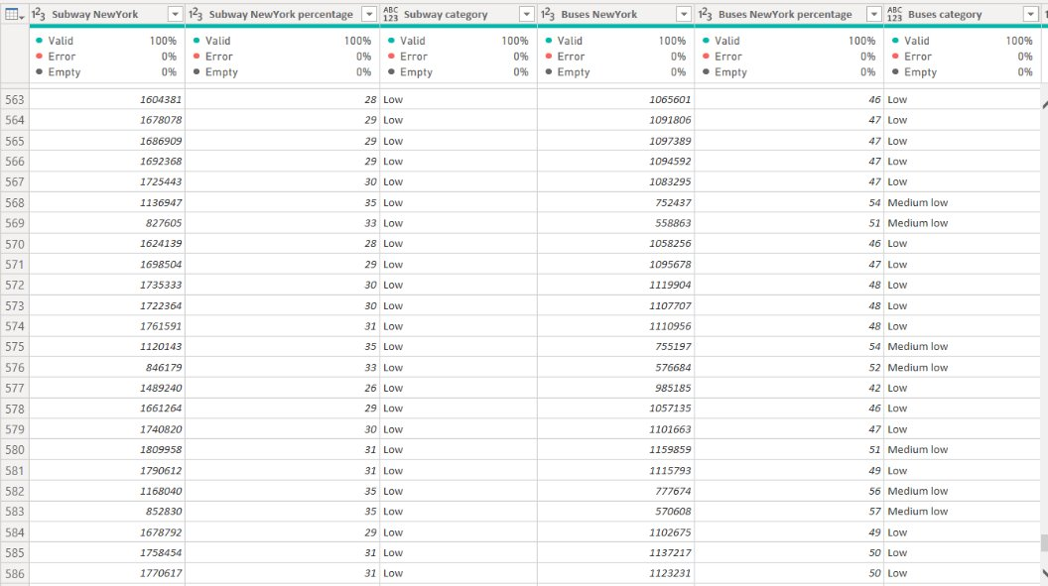
Services

Slide 16

What is the overall trend in total estimated ridership across all MTA services over the given time period?
Which mode of transportation has shown the strongest & weakest percentage recovery compared to its pre-pandemic levels?
Questions

Slide 17


Slide 18
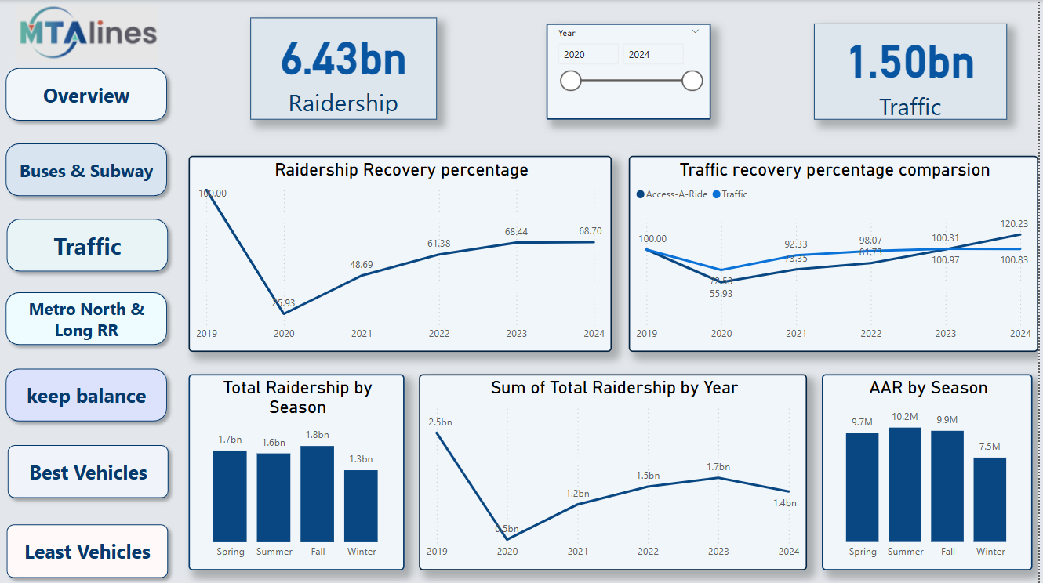
Overview

Slide 19
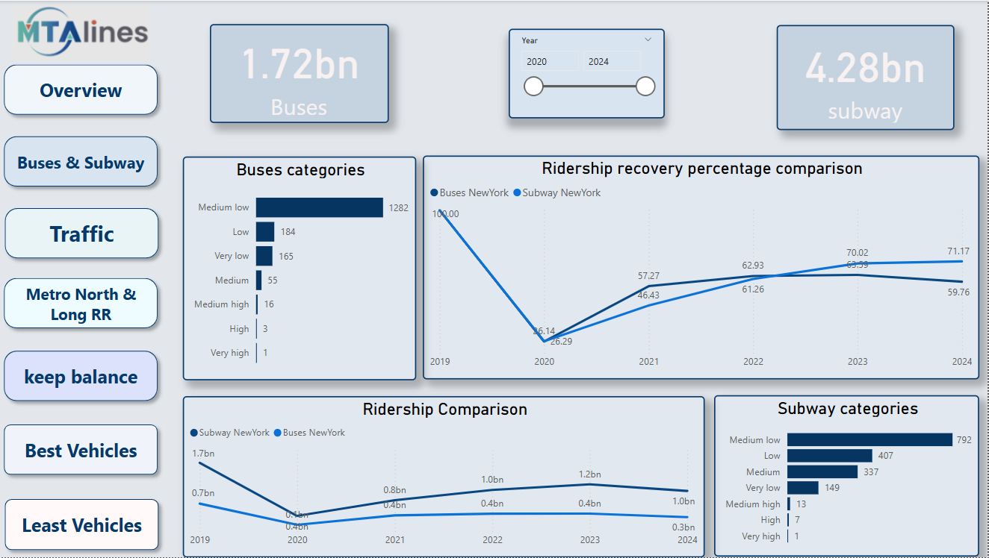
Buses & Subways

Slide 20
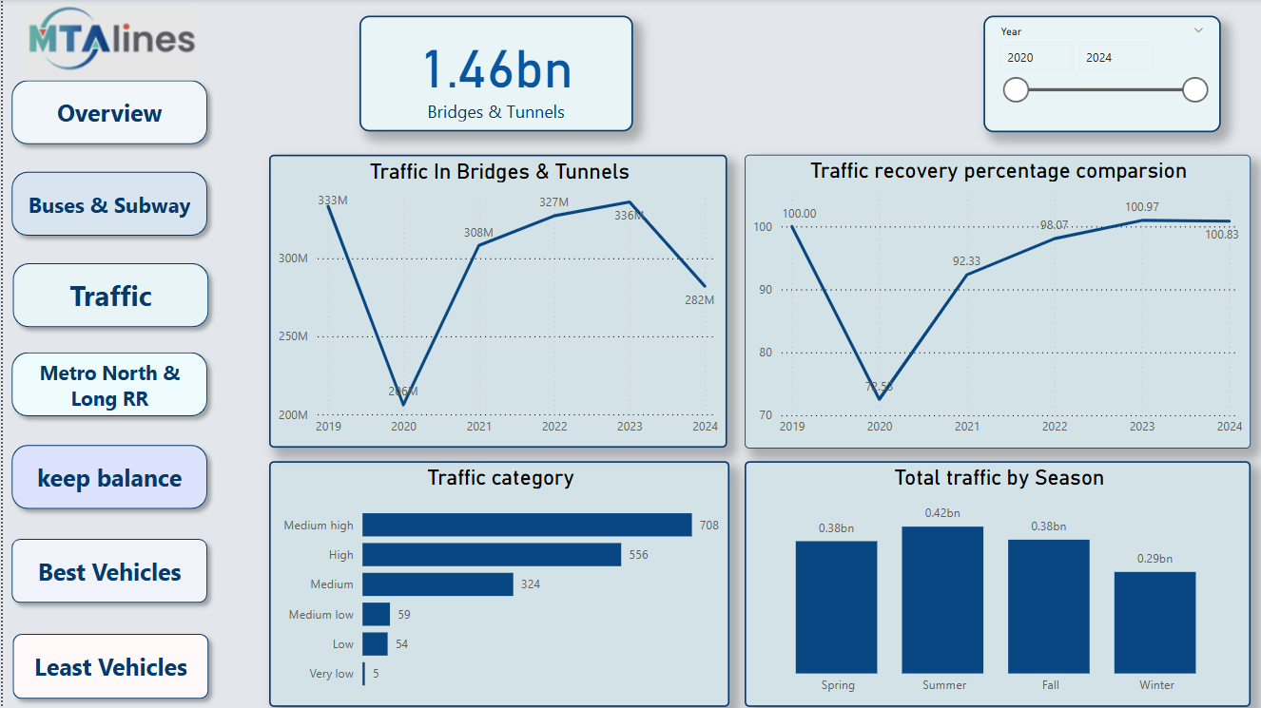
Traffic

Slide 21
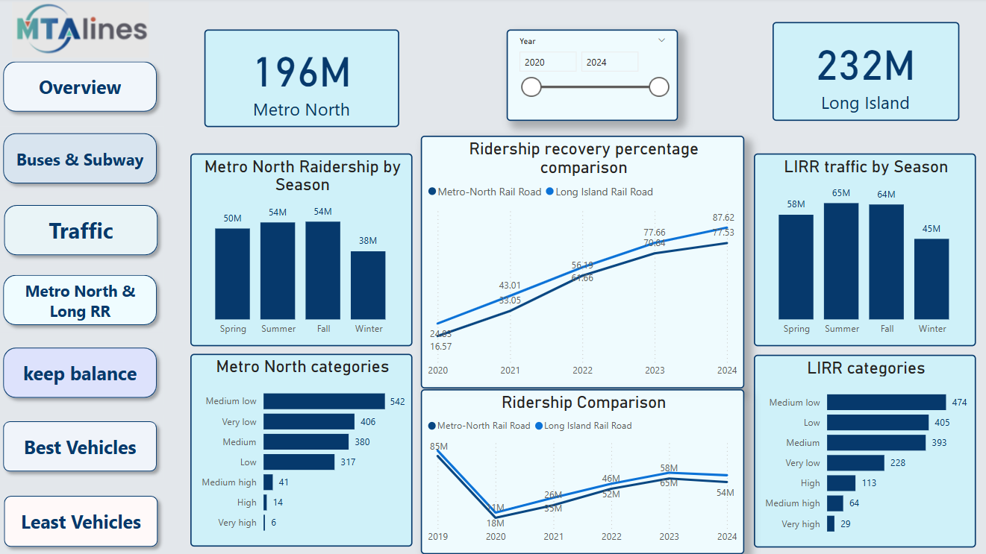
Metro North & Long island

Slide 22
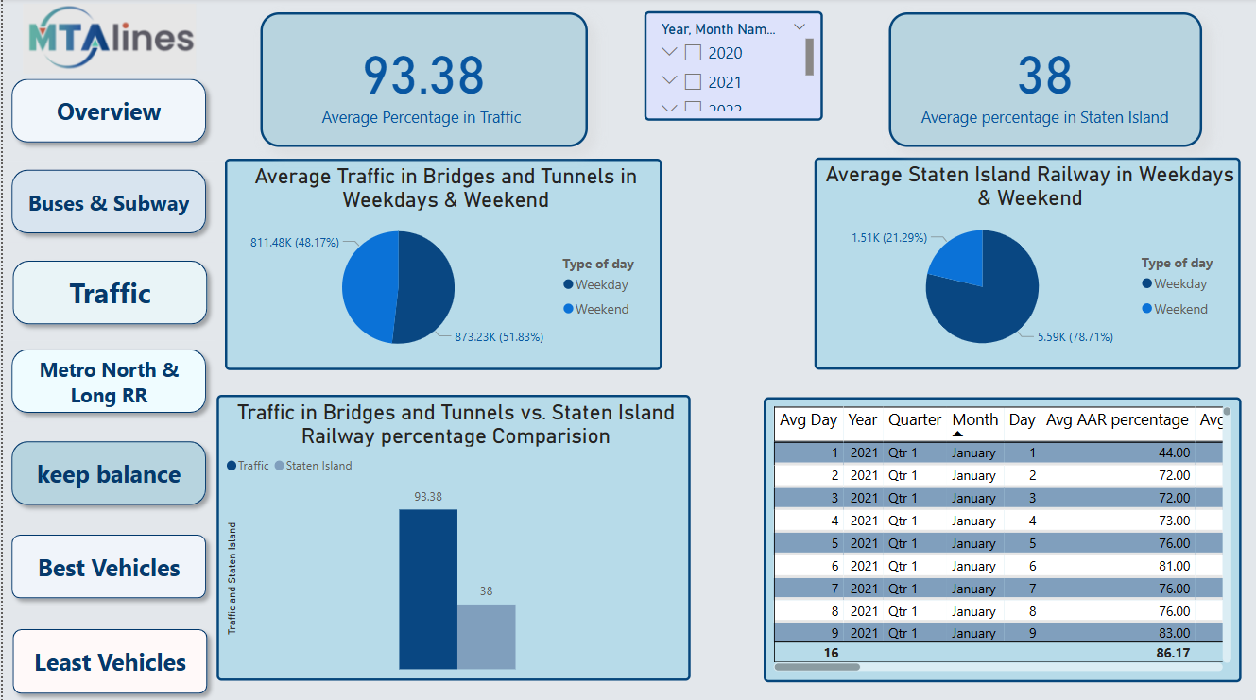
Keep balance

Slide 23
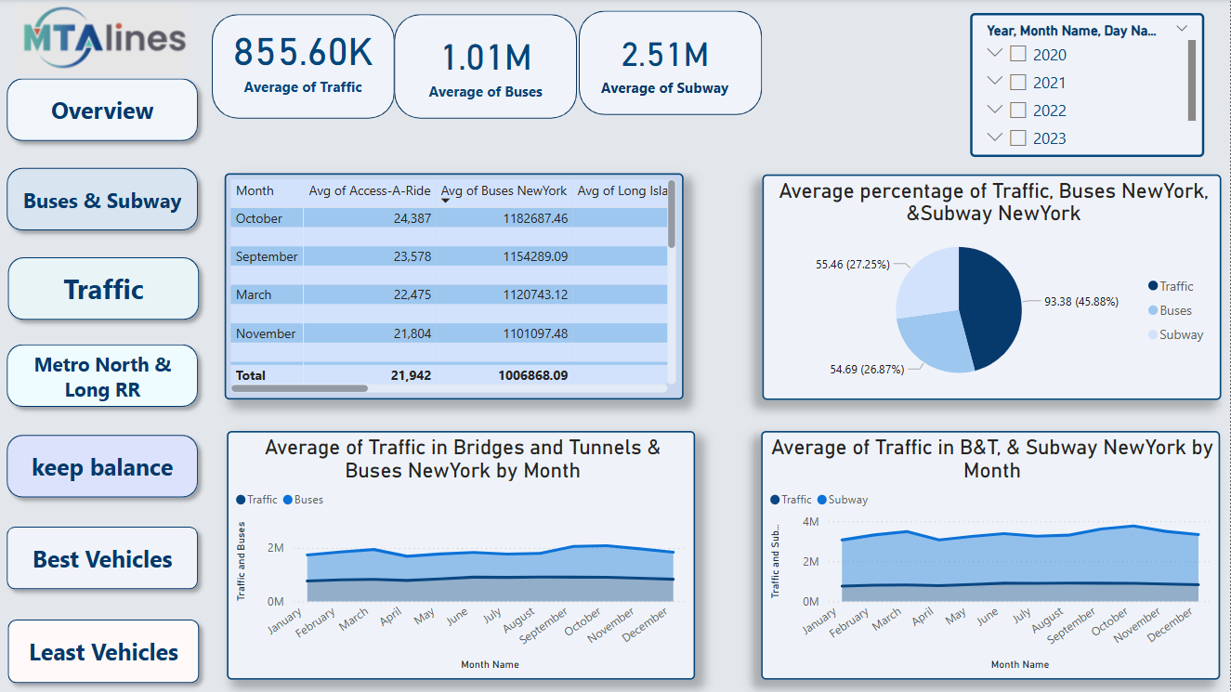
Best Vehicles

Slide 24
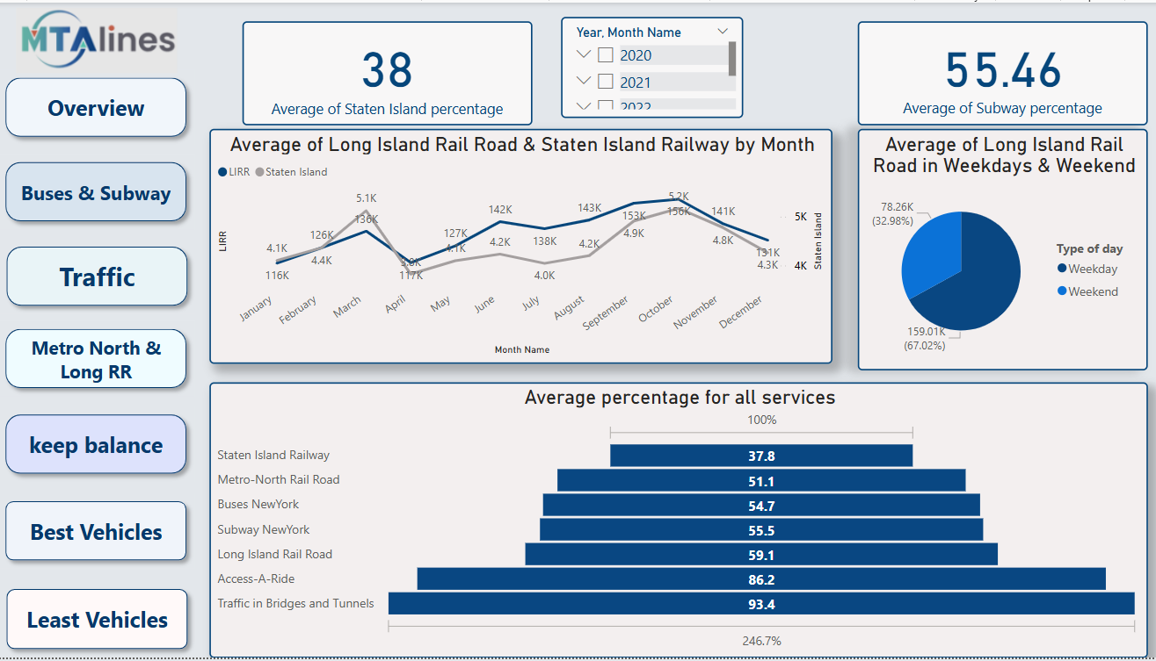
Least Vehicles

Slide 25

Insights

Slide 26
🚊All services had a sharp drop in 2020, the Subway bounced back with a stronger and more stable upward curve, especially noticeable in 2023 and 2024.
🎯The highest month in total ridership across all years is October.
🌧️There is a day in November across all years in ridership exceeded 100% of recovery.
👨‍👨‍👧 All ridership services didn't exceed recovery percentage (75%).
🍁The highest season in ridership is Fall & the lowest is Winter.

Slide 27



🚆Buses still drop to August 2020 and exceeded subway but after December 2022 subway exceeded buses due to his consistency.
🚐 There is a similar pattern between Metro North and Long island are clearly synchronized, suggesting that common external factors influence both services similarly.
✅ Most Bus and Subway records fall under the "Medium Low" category and Very few records for either service reached "High" or "Very High".
🥇Buses is the highest total
️ Staten island is the lowest total & recovery.

Slide 28

🚗The overall traffic has steadily recovered to pre-pandemic levels, that traffic slightly increased about 3% & AAR about 25%.
🚀Traffic in bridges & tunnels are the strongest recovery.
🔵 Traffic volumes are most concentrated in the “Medium-High” and “High” categories
🎯A consistent annual dip in traffic volume is observed every February
🌤Summer sees the highest total traffic while winter records the lowest.

Slide 29

Deploy additional station staff, cleaners, and customer service personnel during October to manage crowd flow and maintain service quality.
Leverage October’s high ridership for awareness campaigns, such as promoting safety, new services, or fare programs.
Boost awareness and possibly incentives during January & February to counter the predictable drop. Schedule planned maintenance or cost-saving adjustments in January & February, when traffic naturally dips.
In buses, expanding the routes that see a high demand and improving the number of flights while reducing the waiting time.
Recommendations

Slide 30

Any Question

Slide 31
Thank
You

